Slide 1

Object Composition
Closures, Revealing Module Pattern, Object Inheritance, Prototypes
SoftUni Team
Technical Trainers
Software University
http://softuni.bg

Slide 2
Table of Content
Object Composition
Closures
Module and Revealing Module Patterns
Object Inheritance and Prototype Chain
Objects Interacting with DOM

Slide 3
Have a Question?
sli.do
#JS-CORE

Slide 4


Object Composition
Objects Holding Other Objects

Slide 5
What is Object Composition?
Combining simple objects or data types into more complex ones
let student = {
firstName: 'Maria',
lastName: 'Green',
age: 22,
location: { lat: 42.698, lng: 23.322 }
}
console.log(student);
console.log(student.location.lat);

Slide 6
Composing Objects
let name = "Sofia";
let population = 1325744;
let country = "Bulgaria";
let town = { name, population, country };
console.log(town); // Object {name: "Sofia", population: 1325744, country: "Bulgaria"}
Combine variables into object
town.location = { lat: 42.698, lng: 23.322 };
console.log(town); // Object {…, location: Object}

Slide 7
Combining Data with Functions
let rect = {
width: 10,
height: 4,
grow: function(w, h) {
this.width += w; this.height += h;
},
print: function() {
console.log(`[${this.width} x ${this.height}]`);
}
};
rect.grow(2, 3);
rect.print(); // [12 x 7]

Slide 8
Printing Objects: toString() Function
let rect = {
width: 10,
height: 4,
toString: function() {
return `rect[${this.width} x ${this.height}]`;
}
};
console.log(rect); // Object {width: 10, height: 4} // This will invoke toString() to convert the object to String console.log('' + rect); // rect[12 x 7]

Slide 9
Problem: Order Rectangles
Create objects to represent the rectangles. Should additionally have two functions:
area() - that returns the area of the rectangle
compareTo(other) - compares the current rectangle with another
Input | Output
[[10,5],[5,12]] | [{width:5, height:12, area:function(), compareTo:function(other)}, {width:10, height:5, area:funciton(),compareTo:function(other)}]

Slide 10
Solution: Order Rectangles
let rects = [];
for (let [width, height] of data) {
let rect = comparator(width, height);
rects.push(rect);
}
rects.sort((a, b) => a.compareTo(b));
return rects;
// Continue on the next slide

Slide 11
Solution: Order Rectangles (2)
function comparator(w, h) {
let rect = {
width: w,
height: h,
area: () => rect.width * rect.height,
compareTo: function (other) {
let result = other.area() - rect.area();
return result || (other.width - rect.width); } }; return rect; }

Slide 12
counter
1
function
function
function
Closures
Enclosing Object State in a Function

Slide 13
What is Closure?
State maintained (closed) inside a function
Hidden from the outside world
Example: counter with closures
function counterClosure() {
let counter = 0;
function getNextCount() {
console.log(++counter); };
return getNextCount; }
let count =
counterClosure();
count(); // 1 count(); // 2 count(); // 3 count(); // 4 count(); // 5

Slide 14
Closures - Shorter Syntax with IIFE
let counter = (function() {
let num = 0;
return function() {
console.log(++num);
};
})();
counter(); // 1
counter(); // 2
counter(); // 3
let counter = (() => {
let num = 0;
return () =>
console.log(++num);
})();
counter(); // 1
counter(); // 2
counter(); // 3
counter(); // 4

Slide 15
Problem: Fibonacci
Write a function that when called
returns the next Fibonacci number, starting at 0, 1
use a closure to keep the current number
Sample execution
let fib = getFibonator(); console.log(fib()); // 1 console.log(fib()); // 1 console.log(fib()); // 2 console.log(fib()); // 3 console.log(fib()); // 5 console.log(fib()); // 8 console.log(fib()); // 13

Slide 16
Solution: Fibonacci
function getFibonator() {
let sum = 0;
let first = 0;
let second = 1;
return function () {
sum = first + second;
first = second;
second = sum
return first; } }

Slide 17
closure
counter
5
function
object
increase()
decrease()
value()
object { }
Module and Revealing Module Patterns

Slide 18
"Module" Pattern (with Object Literal)
let moduleObj = {
count: 0, // public
increase: function(num) { return this.count += num },
decrease: function(num) { return this.count -= num },
value: function() { return this.count }
};
moduleObj.count = 2; // the counter is accessible
console.log(moduleObj.value()); // 2
console.log(moduleObj.increase(5)); // 7
console.log(moduleObj.decrease(1)); // 6

Slide 19
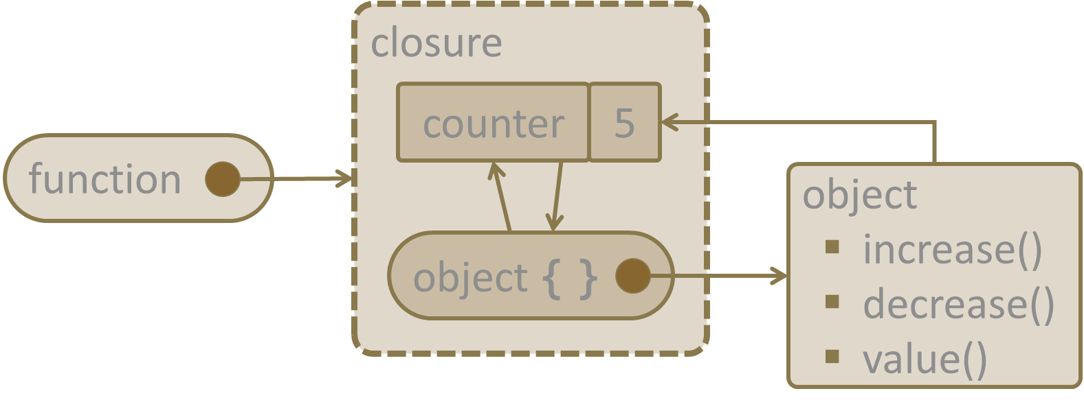
"Module" Pattern (with Closure)
let module = (function() {
let count = 0; // private
return {
increase: (num) => count += num,
decrease: (num) => count -= num,
value: () => count,
};
})();
console.log(module.value()); // 0
console.log(module.increase(5)); // 5
console.log(module.decrease(2)); // 3
console.log(module.count); // undefined (not accessible)

Slide 20
"Revealing Module" Pattern (with Closure)
let revModule = (function() {
let count = 0; // private
function change(amount) { return count += amount; }
function increase(num) { return change(num); }
function decrease(num) { return change(-num); }
function value() { return count; }
return { increase, decrease, value };
})();
console.log(revModule.value()); // 0
console.log(revModule.increase(5)); // 5
console.log(revModule.decrease(2)); // 3
console.log(revModule.count); // undefined (not accessible)

Slide 21
Problem: List processor
Using a closure, create an inner object to process list commands
add - adds the following string in an inner collection
remove - removes all occurrences
print - prints all elements of the inner collection joined by ","
Input | Output
['add hello', 'add again', 'remove hello', 'add again', 'print'] | again, again

Slide 22
Solution: List processor
let arr = []
let command = {
add: function (arr, str) {
arr.push(str)
return arr; }, remove: function (arr, str) {
arr = arr.filter(e => e !== str); return arr }, print: function (str) {
console.log(arr.join(',')); return arr; } }; // Continue on the next slide

Slide 23
Solution: List processor (2)
return function (input) {
for (let e of input) {
e = e.split(' ');
arr = command[e[0]](arr, e[1])
}
}

Slide 24

fathersCar
brand
BMW
model
X5
color
blue
myCar
workCar
model
M4
model
i3
color
red
type
electric
Object Inheritance

Slide 25
Object Inheritance
let fatherCar = { brand: 'BMW',
model: 'X5', color: 'blue',
toString: function() { return `[brand: ${this.brand}, model: ${this.model}, color: ${this.color}]`; }
};
console.log('' + fatherCar);
fathersCar
brand
BMW
model
X5
color
blue
let myCar = Object.create(fatherCar);
myCar.model = 'M4';
myCar.color = 'red';
console.log('' + myCar);
myCar
Object.create() inherits an object
model
M4
color
red

Slide 26
Object Inheritance (2)
let workCar =
Object.create(fatherCar);
workCar.model = 'i3';
workCar.type = 'electric';
workCar.toString = function() {
return `[brand: ${this.brand}, model: ${this.model}, color: ${this.color}, type: ${this.type}]`;
}
console.log('' + workCar);
fathersCar
brand
BMW
model
X5
color
blue
workCar
model
i3
type
electric

Slide 27
Prototype Chain
myCar
fathersCar
model
M4
brand
BMW
color
red
Object
model
X5
__proto__
color
blue
__proto__
workCar
model
i3
type
electric
__proto__

Slide 28
Prototype Chain
Objects have prototype (a parent object)
Prototypes form a prototype chain
If a property is not found in the object itself, it is searched in the parent objects (in the prototype chain)
Object.getPrototypeOf(fatherCar);
// Object {}
Object.getPrototypeOf(myCar);
// Object {brand: "BMW", model: "X5", color: "blue"}

Slide 29
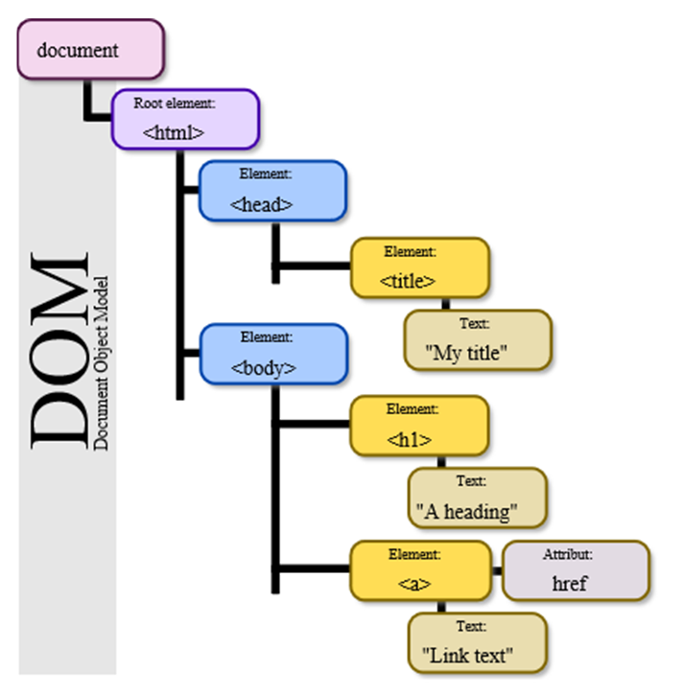
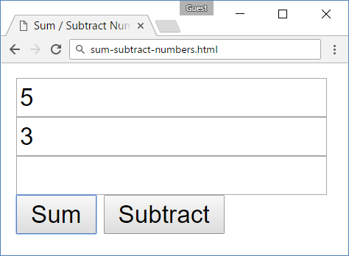
model
init
function
add
function
subtract
function
Objects Interacting with DOM

Slide 30
Example: Calculator
You are given the following HTML form
<input type="text" id="num1" />
<input type="text" id="num2" />
<input type="text" id="result" readonly />
<br>
<button id="sumButton">
Sum</button>
<button id="subtractButton">
Subtract</button>

Slide 31
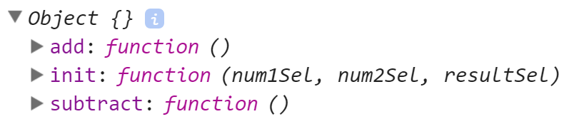
Example: Calculator (2)
Write a JS function getModel() to return a JS object holding:
function init() - initializes selectors for finding the fields num1, num2 and result in the DOM
function add() - calculates result = num1 + num2
function subtract() - calculates result = num1 - num2

Slide 32

Live Exercises

Slide 33

Summary
Object composition combines data and functions into JS objects
The "Module" pattern hides data into a function and reveals a JS object
The "Revealing Module" pattern hides data and functions are reveals them as JS object
Objects can inherit parent object by Object.create(parent)
…
…
…
let r = {w:5, h:3, grow:function() { … }}

Slide 34
https://softuni.bg/courses/javascript-advanced

Slide 35













SoftUni Diamond Partners

Slide 36




SoftUni Organizational Partners

Slide 37




Trainings @ Software University (SoftUni)
Software University – High-Quality Education and Employment Opportunities
softuni.bg
Software University Foundation
http://softuni.foundation/
Software University @ Facebook
facebook.com/SoftwareUniversity
Software University Forums
forum.softuni.bg

Slide 38

License
This course (slides, examples, demos, videos, homework, etc.) is licensed under the "Creative Commons Attribution-NonCommercial-ShareAlike 4.0 International" license

